Slide 1

Extract Transform Load Electric Vehicle Data
- Ali, Kevin & Sri

Slide 2

What is ETL?
ETL is a process that extracts the data from different sources, then transforms the data and finally loads the data into the Data Warehouse system.

Slide 3
ETL Project on Electric Vehicle data of Washington State
Sources: https://www.atlasevhub.com/public/dmv/wa_ev_registrations_public.csv https://catalog.data.gov/dataset/electric-vehicle-population-data
Tools used:
Jupyter notebook
Pandas
SQLalchemy
PgAdmin4
PostgreSQL

Slide 4
Project Scope
To successfully find two Dataset sources and transform it to more refined data and load it into database.
We will be using Electric vehicle data of Washington State to achieve this.
With this process we can understand and learn how the ETL process can analyse and transform and load the data of Electric Vehicle in Washington state.

Slide 5
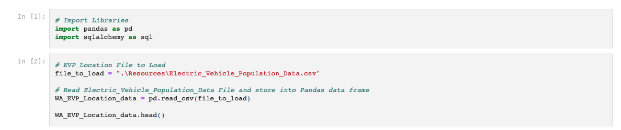
Extract
Used Pandas to import and read the csv files
First file was Electric vehicle population in WA(USA).
Second file was registrations of EV in WA(USA)

Slide 6
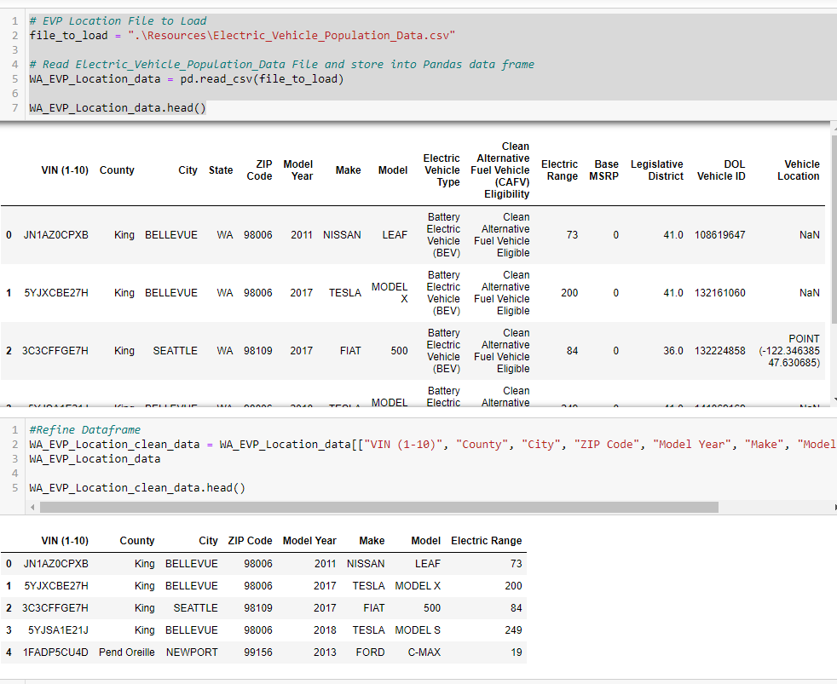
Transform
Electric vehicle population in WA(USA).
Dropped unnecessary columns to retain County Name, City, VIN, Model, Make and range.
Registrations of EV in WA(USA), Similar to first source, we retained and cleaned the needed data.
Once the files were cleaned it was converted to .CSV files to be loaded into the SQL DB.

Slide 7
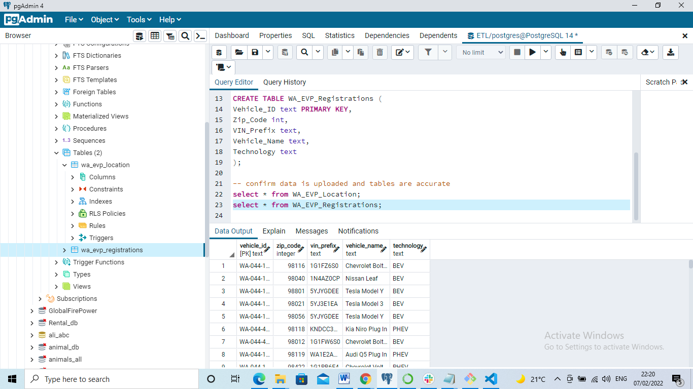
Load
Once the dataset was cleaned and received the CSV files.
Created DB and tables and assigned primary keys to the tables.
Performed import and load the data from the CSV files to the appropriate tables.

Slide 8
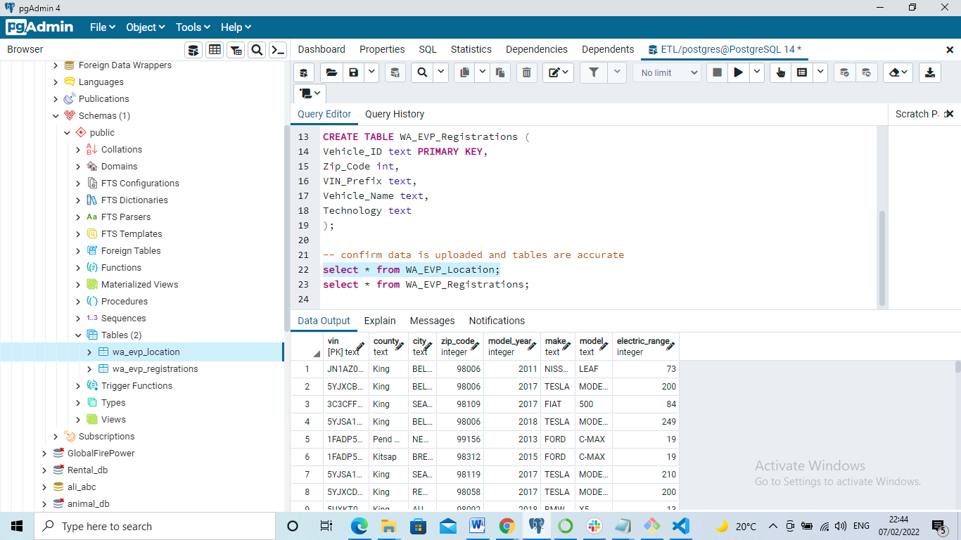
SQL DB
Once the database loaded, we can use SQL commands to view the table.

Slide 9
Conclusion
We sourced datasets and cleaned it with Pandas and created databases and loaded them with the learnings we had over the last couple of weeks.
We performed ETL successfully
We now have 2 tables with Vehicle registrations and population of vehicles in the county which can be utilized to analyse the Electric Vehicles in Washington state.

Slide 10
Thank you

